Slide 1
Radiation Hydrodynamics I: Introduction to Radiation Transport Concepts
July 10, 2010
Louis Howell
Center for Applied Scientific Computing
Lawrence Livermore National Laboratory, P. O. Box 808, Livermore, CA 94551
This work performed under the auspices of the U.S. Department of Energy by Lawrence Livermore National Laboratory under Contract DE-AC52-07NA27344
LLNL-PRES-441092

Slide 2
This first hour is about basic concepts and mathematical models
Physics will be kept to a minimum!
The idea is to build up quickly to mathematical models that describe radiation transport, without getting bogged down with the detailed interactions of individual particles.
I’m going to keep it basic, particularly at the beginning. We’ll pick up the pace a bit as we get into it.
Once we’ve spent an hour on the basic models, Mark will take over and talk about some of the implications for astrophysics.
For the last hour, I’ll come back and talk about some of the issues that come up when doing numerical simulations.

Slide 3
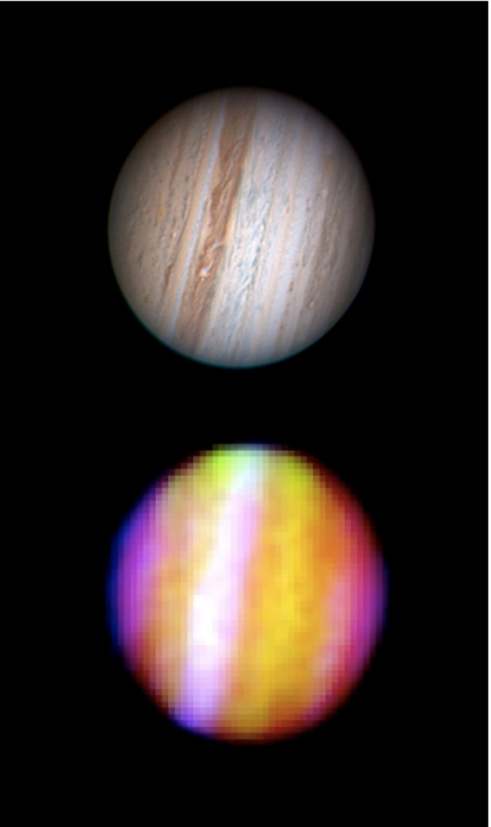
To start with, what exactly do we mean by radiation transport?
Prototype of concept: Photons stream in straight lines, carrying energy from place to place and interacting with matter.
If nothing behaved like this, astronomy would be very boring!
Some other particles behave in similar ways, can be modeled by similar equations, and are worth discussing in the same context.
On the other hand, there are many phenomena in photon physics that go beyond what we usually mean by “radiation transport”.
So before we start writing down equations, let’s be a little more clear about what we’re trying to model.
Notes:
http://apod.nasa.gov/apod/ap100603.html Visible: Anthony Wesley. Infrared: SOFIA (Stratospheric Observatory for Infrared Astronomy)

Slide 4
What we’re mainly concerned with is a continuum approximation to neutral particle transport
For the most part, we are not looking at phenomena associated with the wave nature of radiation:
Diffraction, Refraction, Polarization
We are not concerned with electromagnetic fields, which means that we are dealing with neutral particles traveling in straight lines.
(We also pay little attention to gravity.)
We don’t worry about quantum mechanics, except that we need it to derive the bulk interaction coefficients between radiation and matter.
We assume we have a large enough number of particles to treat the radiation as a continuous field. (continuum approximation)
Radiation is not collisional: the particles interact with matter but not with each other. (If they did interact with each other they would behave more like a fluid.)
The main examples are photons and neutrinos (and neutrons, but not in astrophysics).

Slide 5
Our model of the radiation field has no fewer than seven independent variables!
The radiation intensity is a function of space and time (r,t), of course, which are four of the independent variables.
It is also a function of direction Ω, which is a unit vector and gives us two more. (Since radiation is not collisional it may be strong in one direction and weak in another, even at the same spatial location.)
Finally, it is a function of frequency ν, or particle energy. (Just because intensity is high in the visible, doesn’t mean you have strong X-rays.)
So intensity is I(r,Ω,ν,t), and the units of this are flux (energy per time per unit area normal to Ω) per unit solid angle, per dν. The solid angle part can be thought of as a bundle dΩ of rays near to the direction Ω. dΩ is dimensionless and integrates to 4π over the unit ball of directions.
Alternatively, you could think of I as a function of position, particle momentum, and time, but for our purposes that point of view is not particularly useful.
Ω
dΩ

Slide 6
Mathematically, pure streaming looks like a 1D wave equation along each ray
Focus for a moment on radiation moving to the right along the x-axis:
The intensity will be a function of the form I(r,t) = I(x-ct), an arbitrary waveform moving to the right at speed c.
It will satisfy the 1D wave equation I_{t} + cI_{x} = 0.
Rays in the other directions all do the same thing. They don’t interact with each other. So we write this as a directional derivative in the direction Ω:

Slide 7
As radiation passes through space with some rarefied matter, how do they interact?
We’re talking about interaction with one or a few particles of matter at a time here, not a large chunk of matter with a significant surface area. Surface interactions are a whole separate topic.
There are three conceptually different interactions:
Absorption: radiation hits a particle of matter and stops being radiation; its energy is absorbed by the matter.
Scattering: radiation can hit the matter and bounce off in a different direction. Depending on the scattering process:
There may or may not be an energy change.
The direction of the radiation after the interaction may be correlated to some extent with the direction it had before, or it may bounce off in any direction with equal probability. The latter is isotropic scattering.
Emission: the matter can create new radiation, losing energy in the process. This is the opposite of absorption. Emission generally has no preferred direction and is therefore isotropic.

Slide 8
Wait a second, when radiation passes near a particle of matter, how do we know if they interact at all?
If the matter is “large”, like a dust particle, it has a cross-section in the direction the radiation is moving. If the radiation passes through that cross-section, they interact. Otherwise they don’t.
If the matter is “small”, like an atom, then we need hours of math to figure out if there was an interaction or not. Once we’re done, though, we can interpret the interaction probability as if the atom had a definite cross-section. So let’s just take that answer as given, and let someone else do all the math!

Slide 9
From microscopic to macroscopic cross sections: absorption coefficient
Now suppose we have a number density of N particles per cm³, each with an absorption cross-section a, which has the units of area.
κ=Na has units of inverse length, cm⁻¹.
κ ⁻¹ is the mean free path, the distance a particle can expect to travel (on the average) without being absorbed.
κI is the rate per unit length at which intensity is absorbed into the matter. Combine this with the equation for streaming and we get
In neutron transport κ is sometimes called the macroscopic cross section, to distinguish it from the microscopic cross section a. This is a little silly because κ does not have the units of area. Let’s call it the absorption coefficient instead.

Slide 10
Scattering takes energy from one angular direction and distributes it into other directions
Up until this point the intensities in different directions have been independent of each other.
Define a scattering coefficient σ, also with units of inverse length.
Assume scattering is isotropic.
Add terms for out-scattering and in-scattering to the transport equation:
What if the scattering isn’t isotropic? Add a phase function:
What if the scattering isn’t elastic? …

Slide 11
We add an emission coefficient to complete the picture
The emission coefficient has units of intensity per unit length.
Now think for a moment about the other side of what’s happening here:
Emission and absorption couple the radiation field to the fluid energy.
As the fluid absorbs energy, it gets hotter…
…so it emits more radiation…
…so in effect, absorption and re-emission look a lot like isotropic scattering.
So the more strongly the radiation couples to the fluid, the more the radiation field itself is driven to become isotropic. It’s directionality disappears. We’ll come back to this later.

Slide 12
Radiation-matter interactions can be extremely complicated, but here are a few key examples
Electrons bound in an atom, ion, or molecule have preferred energy levels.
An electron in a high level can drop to a lower level, emitting a photon of the appropriate energy. This emission is concentrated at certain energies and is called line emission.
An absorbed photon can raise an electron to a higher level. This is line absorption.
Together these are called bound - bound transitions.
Emission and absorption at other energies can be much less likely. These are the gaps between spectral lines.
An energetic photon can strip away a bound electron, or a free electron can be absorbed into an open energy level (emitting a photon in the process). These are called bound – free transitions and are not confined to discrete spectral lines.

Slide 13
Free – free emission and absorption are also possible: Bremsstrahlung
An electron in free space can’t emit or absorb a photon, because electrons have no internal energy.
When the electron passes near an ion, though, either of these can happen.
The electron is free both before and after the event, so this is a free – free transition, also known as Bremsstrahlung.
Just for amusement, we can write down emission and absorption coefficients for this process (but even these formulas are approximate):
Note that these are proportional to both the electron and ion densities, which means that in a neutral plasma they will be proportional to ρ².

Slide 14
Thermal emission and scattering
In an optically-thick material, radiation approaches thermal equilibrium. Emission and absorption are then related by the Planck function:
Dust particles, being solid material, can emit or absorb radiation thermally.
They can also scatter radiation: you can think of the radiation as hitting the particles and reflecting off in a new direction.
Radiation can also scatter off of elementary particles (Compton scattering).
Let’s not get bogged down in the interactions, though. They can be extremely complicated to calculate, but the effects can then be “hidden” in the emission, absorption, and scattering coefficients for the transport equation.

Slide 15
Discretizing in frequency (particle energy): the multi-group approximation
In the transport equation, the quantities I, η, κ, σ, are all functions of ν.
To discretize this, we can simply represent each of these at discrete values ν_{i}, enough to capture the essential behaviors of our system.
For some applications, e.g. detailed opacity calculations, we may want to further identify each ν_{i} with a specific interval ν_{i-½} - ν_{i+½}.
If spectral line structure is important, the number of groups necessary could be huge.
For more continuous emission as few as a dozen groups may be acceptable.
The extreme case, often used in practice, is to integrate the whole spectrum into a single energy group. This is the gray approximation. (Or if you’re British, grey.)

Slide 16
Discretizing in angle: the discrete ordinates or S_{n} approximation
The intensities I are also functions of direction Ω.
One way to discretize this is to select a set of directions Ω_{k} and weights w_{k}, which constitute a quadrature set over the unit sphere. If we normalize the weights to sum to 4π the transport equation becomes
A limitation of this approach is that we can generally afford at most hundreds of ordinate directions for the entire sphere, and often far less than that. This is very coarse resolution for transparent media. Solutions are vulnerable to “ray effects”, where radiation is overestimated in some directions and underestimated in others.

Slide 17
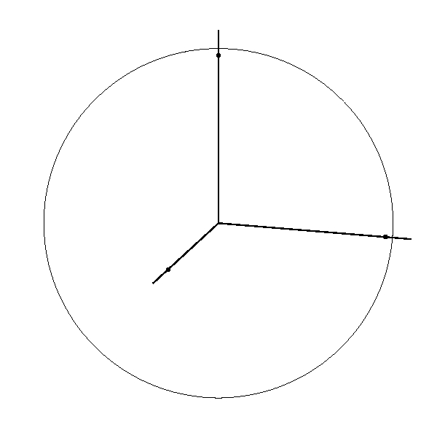
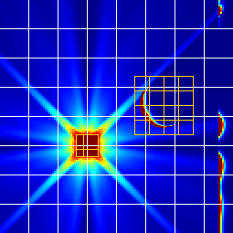
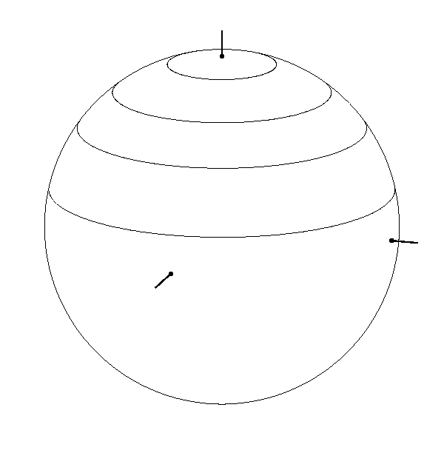
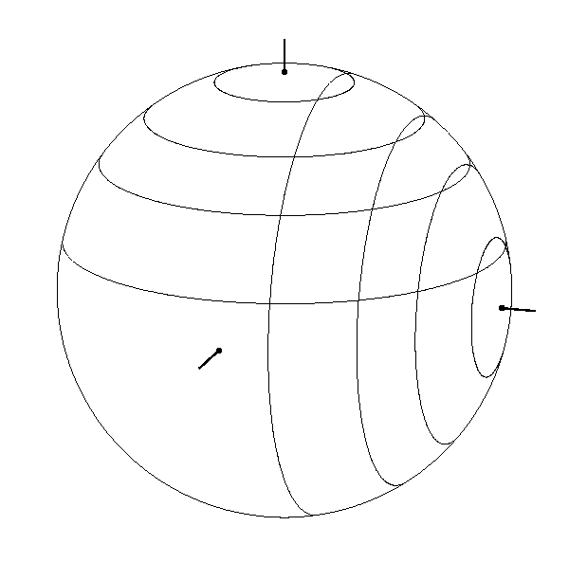
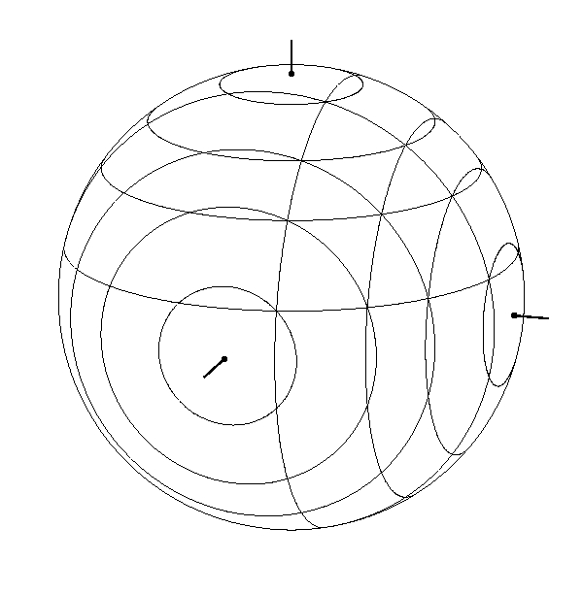
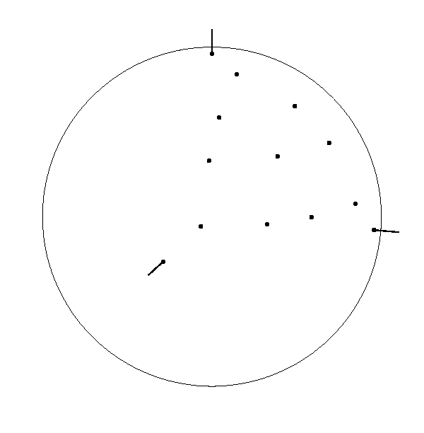
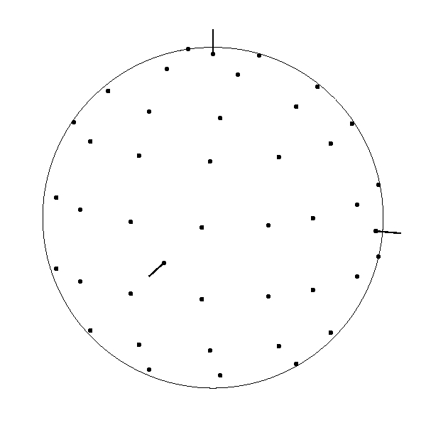
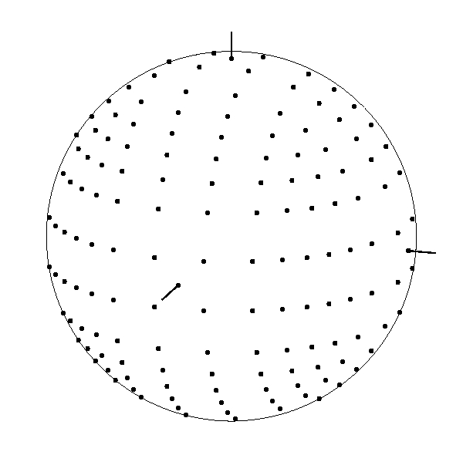
Level symmetric ordinates are a common choice for discrete ordinates simulations
These are ordinates that are unchanged by any exchange of coordinate axes.
Even an S₁₆ calculation can still show prominent ray effects.

Slide 18
Other approaches to angular discretization: P_{n} methods, ray tracing, first scatter
Instead of discrete directions, P_{n} methods decompose the intensity into a series of spherical harmonics.
These are the spherical analogue of Fourier series and spectral methods.
Instead of ray effects, the method is vulnerable to oscillations related to the Gibbs phenomenon.
Solutions are also harder to compute than with S_{n} methods.
Typically only low orders are used.
Ray tracing can give high resolution for a limited number of compact sources, or for visualization from a single vantage point at a time. Generally not practical for coupled radiation-hydrodynamics.
First-scatter is a hybrid approach sometimes used when most of the radiation is coming from a single compact source. Rays are traced from the source to each cell of the domain, then some other method is used for the scattered radiation or secondary emission from these other cells.

Slide 19
Monte Carlo offers an entirely different approach to the issue
In the Monte Carlo method, we don’t try to discretize intensity over a mesh at all. Instead, we fire a large number of random particles through our domain and track where they all go.
Advantages:
Extends to higher dimensions better than mesh-based methods.
Focuses computational effort where the action is.
Relatively easy to add additional physics.
Easy to parallelize over particles since these are independent of each other.
Disadvantages:
Random noise decreases only as square root of number of particles.
Can bog down in optically thick regions, particularly hot ones.
Harder to parallelize by spatial domain decomposition.
Important to have a high-quality random number generator.
Can be hard to debug.
This is an important method and is becoming more popular as we solve harder problems on larger machines; deserves more attention than I’m giving it today!

Slide 20
Taking moments of the intensity forms the basis for simpler methods such as the diffusion approximation
Zeroth moment:
First moment:
Second moment:
Radiation energy density
Radiation flux vector
Radiation pressure tensor

Slide 21
We take moments of the transport equation to find equations for the first two moments of intensity
Start with the first two moments:
To close this system (two-moment closure), we need an expression for K. The simplest is K^{ij}=δ^{ij}J/3, the Eddington approximation. (Fancier approximations would lead us to Eddington factors and flux limiters.)
This is the P₁ equation. The equations for J and H together constitute a first-order hyperbolic system, so signals propagate at finite speed. Unfortunately, it is the wrong speed. The characteristics for this system move at speed . Still, it isn’t an awful solution, and there are tricks people have tried to fix it up.

Slide 22
The next step is the diffusion approximation, which we obtain by eliminating H from the system entirely
In the H equation, neglect the time derivative and solve for H, giving an expression for the flux in the form of Fick’s Law of diffusion:
Then substitute this back into the J equation to obtain a diffusion equation for J:

Slide 23
Diffusion is not valid in transparent media, but flux limiters can be added in an attempt to keep it sane
The diffusion approximation breaks down in free-streaming regions. Information travels at infinite speed, and as the material becomes transparent the diffusion coefficient goes to infinity.
Flux limiters are attempts to dial down the diffusion coefficient in such cases to extend the applicability of the model. They are something of a black art.
Example: Levermore-Pomraning limiter for unit effective albedo:
, where

Slide 24
When radiation is near thermal equilibrium we can derive a gray diffusion approximation
This diffusion equation is still frequency-dependent. For a gray model we need coefficients averaged over all frequencies. Different averages are appropriate for emission / absorption and for the diffusion coefficient.
These are the Planck and Rosseland averages, respectively. It is interesting to note that the peak of the Rosseland weighting factor ∂B_{ν}/∂T is at higher energies than that of the Planck function itself, meaning that in diffusion the energy transfer is dominated by high-energy photons.

Slide 25
In opaque media radiation and fluid have the same temperature, and we can treat them as one ‘material’
This is an equation for the combined fluid and radiation energy. But with both fluid and radiation at the same temperature, and E_{R}=4σT⁴/c, we can write the radiation flux as a heat conduction term:
As a component of the fluid, radiation contributes to the equation of state with
The combined equation above has no terms corresponding to radiation advection and pressure. These should be included, and in a few slides we’ll see what they look like.

Slide 26
Different approximations are valid in different regimes. Let’s summarize:
Radiation moment equations: Angular variation is sufficiently smooth that a small number of moments adequately capture the dependence of intensity on direction.
Eddington approximation: The pressure tensor is effectively isotropic.
Diffusion approximation: Radiation flux can be treated as proportional to gradients of radiation energy density. This is qualitatively correct even when inaccurate, and is such a useful approximation that hacks such as flux limiters are used to extend it beyond the diffusion regime.
Gray radiation approximation: The spectral dependence of radiation is close to a Planck function, so there is a well-defined radiation temperature. (“2T”)
Radiation heat conduction: The radiation temperature is closely coupled to the fluid temperature. (“1T”)

Slide 27
Radiation heat conduction is nonlinear and yields solutions called ‘thermal waves’ or ‘Marshak waves’
At high temperatures radiation effects can be much faster than hydro. Assume we can neglect both hydro and the energy content of the radiation field. We get a simplified heat conduction equation
The coefficient κ_{R} can itself often be approximated by a power law. (For bremsstrahlung, for example,
Conductivity is small at low temperatures but rises quickly at higher temperatures.
Solutions where radiation is penetrating into a cold region therefore show a sharp front, with a smoother high-temperature region behind it. This is very different from the extended diffusion region seen with linear heat conduction.

Slide 28
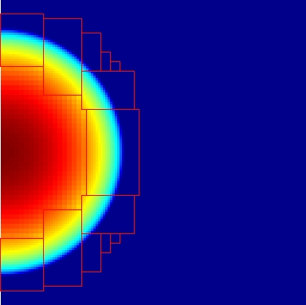
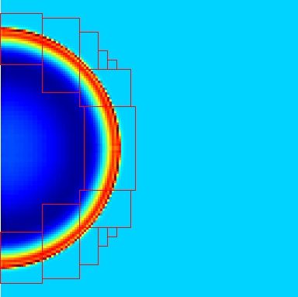
A thermal wave propagating from a point source expands into the cold fluid with a sharp front
fluid energy
matter density
As the thermal wave expands and cools it slows down and begins to transition into a shock. The Marshak wave solution gives way to the Taylor-Sedov blast wave solution.

Slide 29
We have neglected the motion of the fluid: radiation pressure, advection, and Doppler shift effects
Must start thinking in relativistic terms! What frame are we in, anyway?
The diffusion approximation is valid in the co-moving frame, which means the frame locally at rest with respect to the fluid.
Interactions with the fluid are also much easier to represent in the co-moving frame. In other frames emission isn’t even isotropic!
The drawback is that the frame is tied to the fluid and is therefore not the same everywhere. Transport is very difficult to solve as the rays appear to follow curved paths! For diffusion or the moment equations, though, it isn’t too bad.
Castor (2004), Buchler (1983):
(See the paradox?)

Slide 30
In the mixed-frame formulation, radiation is computed in the fixed frame, fluid interactions in comoving frame
Hubeny and Burrows (2007), Mihalas and Klein (1982):

Slide 31
There are contributions to the fluid momentum as well as to the energy
Mixed-frame formulation:

Slide 32
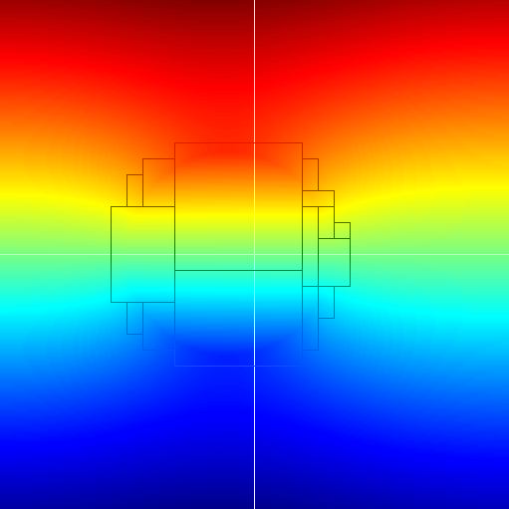
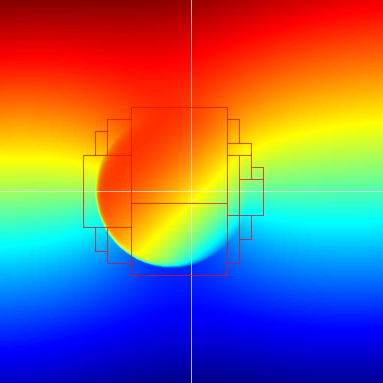
This shows radiation energy density with a varying scattering coefficient, with and without fluid motion
Scattering coefficient is higher by a factor of 10⁴ in the central region
Velocity in second frame is toward lower left at 0.05c

Slide 33
Radiation Hydrodynamics II: Computational Diffusion and Transport
July 10, 2010
Louis Howell
Center for Applied Scientific Computing
Lawrence Livermore National Laboratory, P. O. Box 808, Livermore, CA 94551
This work performed under the auspices of the U.S. Department of Energy by Lawrence Livermore National Laboratory under Contract DE-AC52-07NA27344
LLNL-PRES-441092

Slide 34
In this second hour we’ll look at some computational issues for radiation hydrodynamics
These are necessarily just examples, drawn from projects I’ve worked on myself.
We’ll start with block-structured adaptive mesh refinement, to set the context for the radiation algorithms to follow.
Gray (single-group) radiation diffusion.
Implicit coupling to the fluid energy.
Radiation transport using the discrete ordinates discretization.

Slide 35
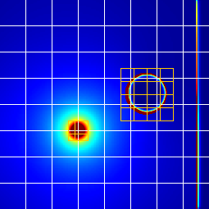
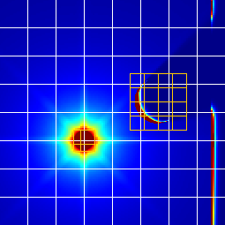
Radiation diffusion is contrasted here with discrete ordinates, both using a gray approximation
These are single group calculations with radiation coupled to fluid energy, but no hydrodynamics. All three use block-structured adaptive mesh refinement (AMR) with synchronization between levels to enforce energy conservation. Fluid energy is shown. Transport uses the step characteristic discretization.
(Gray transport is not a very realistic approximation, but the discussion will be complicated enough without adding multigroup issues!)
Flux-limited Diffusion
S₁₆ (144 ordinates)
144 equally-spaced ordinates

Slide 36
Axisymmetric Crooked Pipe Problem
Diffusion S₂ Step S₈ Step S₂ SCB S₈ SCB
Radiation Energy Density

Slide 37
Axisymmetric Crooked Pipe Problem
Diffusion S₂ Step S₈ Step S₂ SCB S₈ SCB
Fluid Temperature

Slide 38
AMR Essentials: These are block-structured grids, with finer patches where more resolution is needed
Two levels of refinement are shown here. There could be many more.
All grids are rectangular (for efficiency) but they are not all the same size.
In parallel, different grids are assigned to different processors, often several to each processor.
Even when coarse and fine grids overlap, they are typically on different processors.
Fine levels run with smaller timesteps than coarse levels.

Slide 39
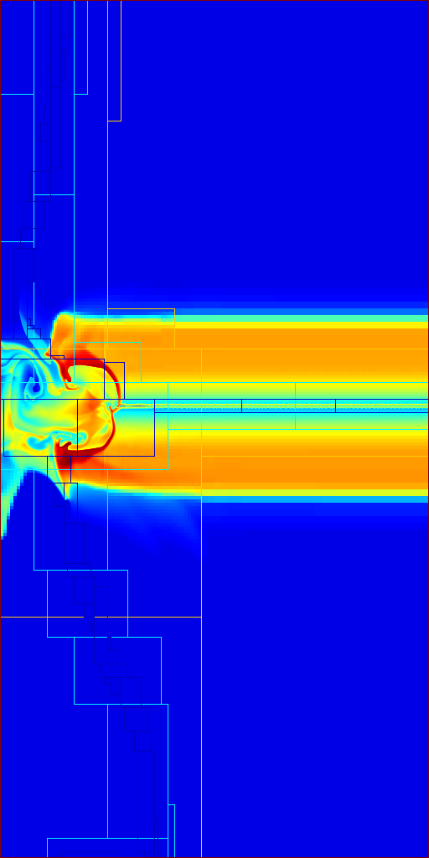
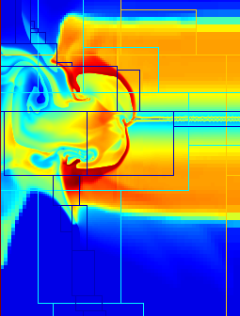
This example has coupled hydrodynamics and four levels of AMR refinement
Single-group radiation diffusion is coupled with multi-fluid Eulerian hydrodynamics. Fine grids concentrate near material interfaces and regions where higher resolution is needed.

Slide 40
Diffusion and transport are different PDEs, but we can use similar finite volume methods for both
We place conserved quantities on cells and work in terms of conserved fluxes through the faces of those cells.
Each flux moves a certain amount from one cell to another, so the total quantity over the whole domain is conserved.
For diffusion, fluxes come from all adjacent cells. We can formulate the problem as a linear system of equations implicitly coupling all the cells together, and pass this to a standard linear solver package.
For transport, fluxes enter a cell from the “upstream” faces and leave through the “downstream” faces, as defined by the ordinate direction.
The traditional way to solve this is through “transport sweeps”. We start at the upstream side of the domain and sweep to the downstream side. Iteration is required for coupling due to boundary reflections and scattering.

Slide 41
Diffusion, transport, and the coupling to fluid energy are all potentially stiff compared to hydrodynamics
Start with gray, flux-limited diffusion conservatively coupled to fluid total energy:
Operator split hydro, discretize coupling terms and diffusion implicitly:
In the last equation, (ρe)– is the fluid internal energy with the hydrodynamic update to time n+1 but before the radiation update.

Slide 42
Diffusion, transport, and the coupling to fluid energy are all potentially stiff compared to hydrodynamics
For transport we’ll also be gray, but throw in some isotropic scattering:
Operator split hydro, discretize coupling terms and transport implicitly:

Slide 43
It’s one thing to talk about solving the coupling implicitly, but how do we actually do it?
Let’s work it through for diffusion. (Transport can be done in the same way.) Express the implicit time discretization as a nonlinear system of equations.
We want to solve this for F_{T} = F_{R} = 0, so form an iterative update using Newton’s method:

Slide 44
Solve for the Newton updates ΔT and ΔE_{R} by forming the Schur complement
The second row is now independent of ΔT. It is in fact a modified diffusion equation which we can solve for ΔE_{R} = E_{R}^{n+1} – E_{R} .
We can simplify this by giving a name to a quantity that appears on both sides:

Slide 45
Add the updates to the prior values to obtain improved estimates for both radiation and fluid energy
For clarity, mark with a ‘*’ all quantities evaluated at the previous iteration.
Now expand F_{R}* and F_{T}*, making this an equation for E_{R}^{n+1} = E_{R}* + ΔE_{R} :
And then do the same thing to ΔT to get a conservative update for fluid energy:
For the first iteration, start with e* = e– and E_{R}* = E_{R}^{n}. If we want to do more iterations, the n+1 quantities here become the new * quantities for the next pass.

Slide 46
Implicit coupling works out the same way for transport: we get a modified transport equation
The main difference from diffusion is that the implicit effect of absorption and re-emission appears in the effective transport equation as isotropic scattering.
We can simplify the transport equation by gathering like terms together:

Slide 47
So time discretization and implicit coupling modify diffusion and transport, but don’t change their nature
Diffusion is still a diffusion equation. It must be solved implicitly, and will couple together all the active cells of the mesh, but this is a standard PDE in a form supported by a variety of solver libraries. Solvers based on multigrid methods can give nearly optimal scaling on large parallel machines. It’s still a hard problem, but it’s a known hard problem!
Transport is still transport. The implicit coupling introduces an effective scattering term even if there is no physical scattering in the problem.
The transport equation can be solved by sweeping from upstream to downstream in each ordinate direction. We continue sweeping until the coupling from boundaries and scattering has converged.
If the scattering term is strong then convergence may be slow. We can accelerate it by conjugate gradient, or by Diffusion Synthetic Acceleration (DSA).
For transport, sweeps remain the computational bottleneck. Their sequential nature also makes them tricky to parallelize.

Slide 48
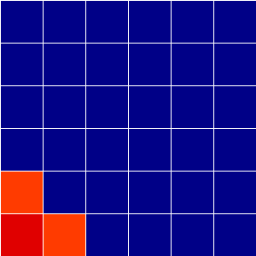
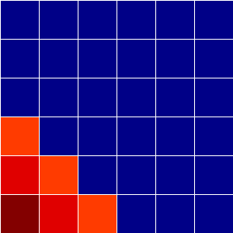
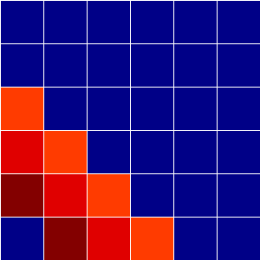
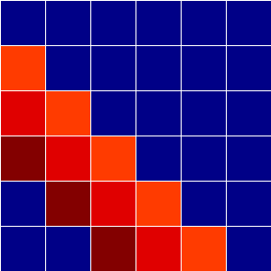
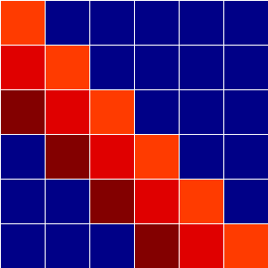
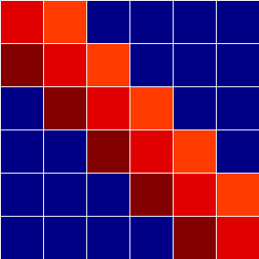
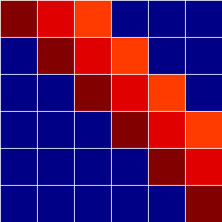
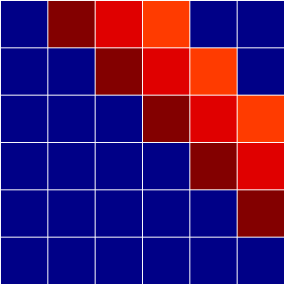
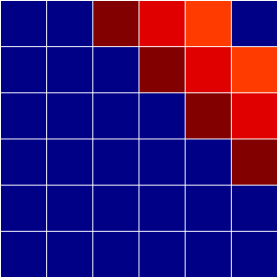
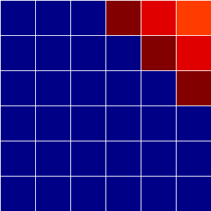
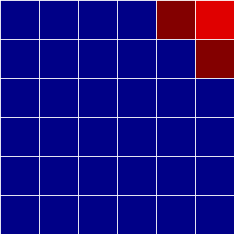
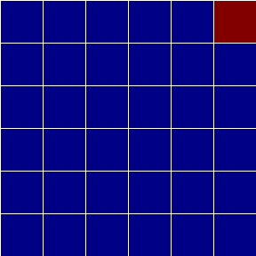
Parallel transport sweeps introduce dependencies, so processors can’t all do the same thing at once
To sweep a single ordinate, a grid needs information from the grids on its upstream faces
Different grids sweep different ordinates at the same time
2D Cartesian, first quadrant only of S₄ ordinate set: 13 parallel stages to get through 3 ordinates

Slide 49
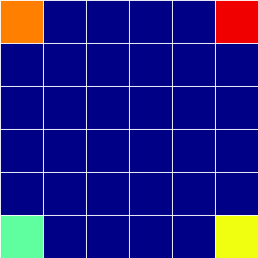
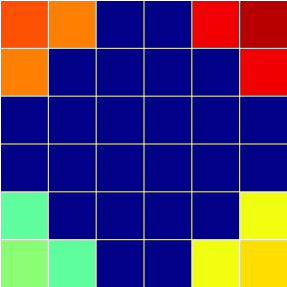
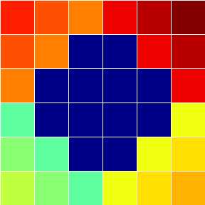
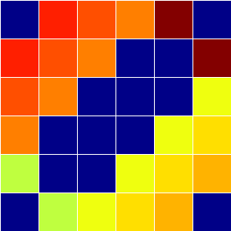
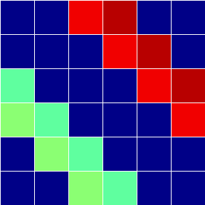
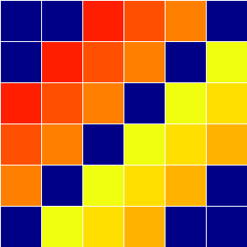
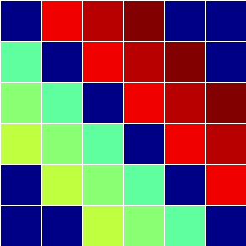
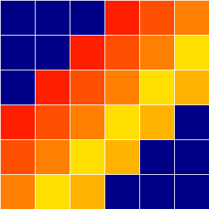
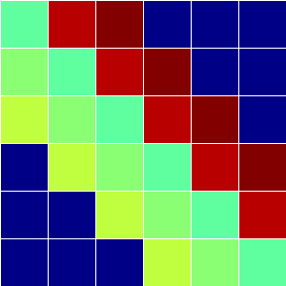
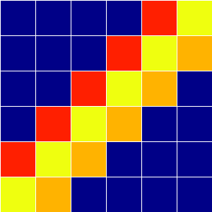
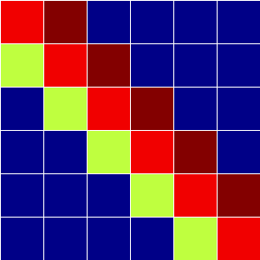
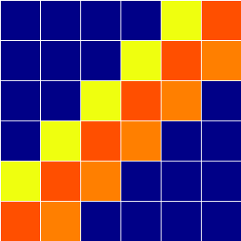
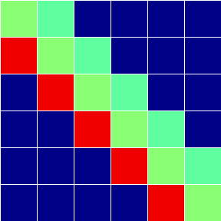
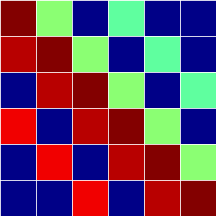
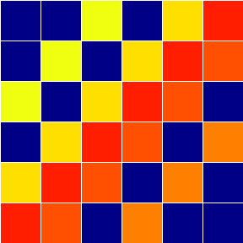
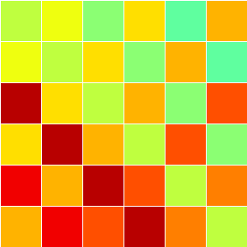
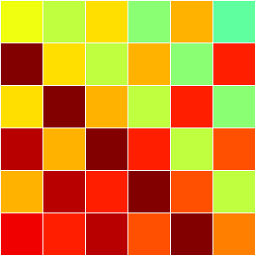
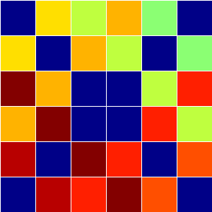
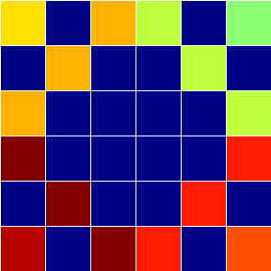
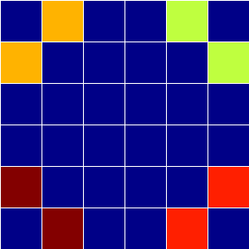
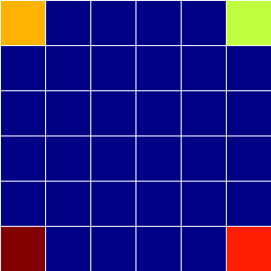
For increased efficiency, we can sweep all four quadrants at once
We start the sweeps from all four corners of the domain, using different processors.
When the wavefronts meet in the center some ordinates have to wait for available processors.
2D Cartesian, all four quadrants of S₄ ordinate set: 22 parallel stages to get through 12 ordinates

Slide 50
In axisymmetric coordinates, angular differencing introduces additional dependencies
In axisymmetric (RZ) coordinates, angular differencing transfers energy from ordinates directed inward towards the axis into more outward ordinates. The inward ordinates must therefore be swept first.
2D RZ, S₄ ordinate set requires 26 stages for 12 ordinates, up from 22 for Cartesian

Slide 51
In AMR we can have both single-level and multi-level transport sweeps

Slide 52
Transport sweeps attack one ordinate at a time, treating info from other ordinates as fixed sources
Three “sources” must be recomputed after each sweep, and iterated to convergence:
Scattering source
Reflecting boundaries
AMR refluxing source
The AMR source converges most quickly, while the scattering source is often so slow that convergence acceleration is required.

Slide 53
In an AMR problem the parallel stages are less regular but the basic ideas are still the same
43 level 1 grids, 66 stages for 40 ordinates (S₈) (20 waves in each direction):
Stage 4
Stage 15
Stage 34
Stage 62

Slide 54
In 3D AMR, there may be no grid upstream of all the others, so no place to start a sweep!
In 2D, grids are sorted for each ordinate direction.
In 3D, sorting isn’t always possible—loops can form.
The solution is to split grids to break the loops.
It is possible to always choose splits in the z direction only (or any other direction you prefer). This is good because it can help with data locality.
Bottom line on transport: we can parallelize sweeps to some extent, but these methods will not scale up forever. For tomorrow’s ridiculously parallel machines we’re likely to need a new approach.

Slide 55
Suggested references:
Mihalas and Mihalas, Foundations of Radiation Hydrodynamics, 1984.
Rigorous and mathematical, sometimes hard to follow.
Reprinted in 1999 in a cheap Dover edition!
Castor, Radiation Hydrodynamics, 2004.
Also mathematical, but more concise, readable, intuitive…
…and expensive.
Zel’dovich and Raizer, Physics of Shock Waves and High-Temperature Hydrodynamic Phenomena, 1966 & 1967.
Approaches subject more from the practical side of the physics. Includes a greater variety of phenomena, gets less bogged down in the math.
Reprinted in 2002 in a cheap Dover edition that includes both earlier volumes!

