Slide 1
Turbulence in accretion disks
UCSC Santa Cruz 2010
Pawel Artymowicz
U of Toronto
MRI turbulence
Some non-MRI turbulence
Roles and the dangers of turbulence

Slide 2
I borrowed some figures & slides from
X. Wu (2004)
R. Nelson (2008)

Slide 3
Accretion disks in
Binary stars (e.g., cataclysmic variables)
Quasars and Active Galactic Nuclei
Protostellar disks ~ protoplanetary disks
accrete (dump mass onto central objects) and radiate

Slide 4
Mystery of viscosity in disks:
Disks need to have Shakura – Sunyayev α (alpha) ~ from 0.001 to 0.1, in order to be consistent with observations
[ν= α c h is known from dM/dt =3πνΣ]
such as UV veiling, Hα emission line widths etc.,
which demonstrate sometimes quite vigorous accretion onto central objects.
What is the a priori prediction for the S-S parameter, which cleverly combines all our ignorance into a single number?
Well, that depends on the mechanism of instability!

Slide 5
Possible Sources of Turbulence (α)
Molecular viscosity (far too weak, orders of magnit.)
Convective turbulence (Lin & Papaloizou 1980, Ryu & Goodman 1992, Stone & Balbus 1996)
Electron viscosity (Paczynski & Jaroszynski 1978)
Tidal effects (Vishniac & Diamond 1989)
Purely hydrodynamical instabilities: Dubrulle (1980s) and Lesur & Longaretti (2005) – anticyclonic flows do not produce efficient subcritical turbulence
Gravito-turbulence (Rafikov 2009)
Baroclinic instabilities (Klahr et al. 2003)
Modes in strongly magnetized disks (Blockland 2007)
MRI

Slide 6
You need to start with basic equations (though I won’t!)
Magnetorotational Instability (Balbus & Hawley1991,...)

Slide 7
History
Velikov (1959), Chandrasekhar (1960) independently found global instability; Fricke (1969) studied the local instability and derived dispersion relations; Balbus and Hawley simplified everything (1991) and connected to the disk accretion problem

Slide 8
Why ideal MRI should work in astrophysical disks
Requirements
Angular velocity decreasing with radius
Subthermal B with a poloidal component
Sufficient ionization
Fastest growing modes
Why ideal MRI may not work in disks
Insufficient irradiation
Insufficient coupling
Subu’s undead zones
Grains lower ionization

Slide 9
Experiments? Possible, not easy
MRI can be observed in a lab with a rotating apparatus, using metals such as gallium (Ji, Goodman & Kageyama, 2001)
Experiment:
MRI observed in lab:
Sisan et al. 2004, PhRvL, 93

Slide 10
Selected Early References
Balbus and Hawley 1991, ApJ 376, 214
Desch 2004, ApJ, 608, 509
Ji, Goodman & Kageyama, 2001, MNRAS, L1
Stone, Hawley, Balbus & Gammie 1996, ApJ 463, 656
Kristen 2000, Science, 288, 2022

Slide 11
Simulations and their problems
Stone, Hawley, Balbus & Gammie, 1996, ApJ 463, 656

Slide 12
Non- magnetic convection MHD MRI

Slide 13
Original estimates of strength (alpha) of angular momentum and mass transport - very optimistic
Balbus and Hawley (1990s) :
depending on the geometry of the external field,
could reach α= 0.2-0.7 if field vertical, or 10 times
less if toroidal.
Taut and Pringle (1992) : α~ 0.4
Usually, non-stratified cylindrical disks assumed

Slide 14
More recently…
much reduced estimates of maximum alpha: α~1e-3
In the past, special non-zero total fluxes and configurations of B field were assumed; local - periodic boundaries, no vertical stratification
(e.g. Fromang and Papaloizou 2007; Pessah 2007)
This caused a dependence of αon these rather arbitrary assumptions
They can be relaxed, i.e. something like a disk dynamo can occur in a total zero flux situation
(cf. Rincon et al 2007)

Slide 15
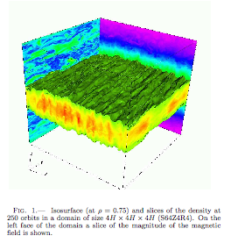
Davis, Stone & Pessah (2009)

Slide 16
Sustained MRI turbulence in local simulations of stratified fluids with zero net B
Davis, Stone & Pessah (2009)
❉ find numerical convergence (consistency of field densities and stresses with growing resolution, even without added dissipation), which was lacking or not demonstrated in the zero-flux unstratified simulations and some shearing box stratified simulations such as Brandenburg et al. (1995) and Stone (1996)
❉ Generally, magnetic stress ~0.01 of the midplane pressure (except in magnetically dominated corona)
❉ Some intriguing time-variations of mean stresses

Slide 17
Doubts about shearing boxes and a call for subgrid scale modeling
On the viability of the shearing box approximation for numerical studies of MHD turbulence in accretion disks. Regev & Umurhan (2008)
inconsistencies in the application of the SB approximation
the limited spatial scale of the SB;
the lack of convergence of most ideal MHD simulations
side-effects of the SB symmetry and the non-trivial nature of the linear MRI; and
physical artifacts arising from the very small box scale due to periodic boundary conditions
``The computational and theoretical challenge posed by the MHD turbulence problem in accretion disks cannot be met by the SB approximation, as it has been used to date.”

Slide 18
A need for a good vertical coverage and resolution (10 scale heights)
“Connections between local and global turbulence in accretion disks”
Sorathia, Reynolds and Armitage (2010)
Globally zero-flux disks behaves like a collection of magnetic domains
These regions connect through a corona

Slide 19
MHD turbulence in accretion disks: importance of the magnetic Prandtl number
Fromang & Papaloizou et al. (2010)
✵microscopic diffusion coefficients (viscosity and resistivity) are important in determining the saturated state of the MRI transport.
✵numerical simulations performed with a variety of numerical methods to investigate the dependance of α, the rate of angular momentum transport, on these coefficients.
✵ α is an increasing function of Pm, the ratio of viscosity over magnetic resistivity (Pm = ν/η). In the absence of a mean field, MRI–induced MHD turbulence decays at low Pm.

Slide 20
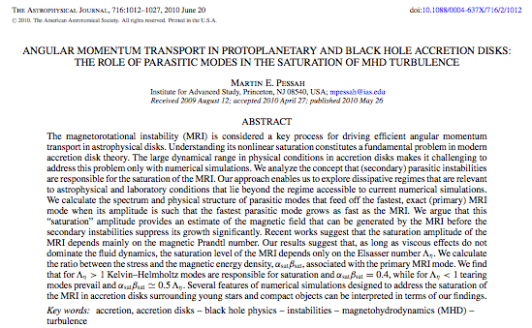
Λ=σB^2/ρΩ

Slide 21
Applications of turbulent disks

Slide 22
Application to CVs
Figure 1. The evolution into quiescence of a disk annulus located at 2 × 10¹⁰ cm from a central white dwarf is shown. The solid line represents the disk thermal equilibrium. The middle section, which corresponds to partially ionized gas, is unstable and forces the annulus to a cyclic behavior. The triangles represent the evolution of the annulus. At low state with such a low level of ionization, MHD turbulence dies away.
Kristen 2000, Science, 288, 2022

Slide 23
Accretion and destruction of planetesimals in turbulent disks
Ida, Guillot and Morbidelli (2008)
Dispersion of planetesimal velocities in a turbulent disk is pumped
up by gravitational pull of non-uniformities.
This is dangerous for planetesimal survival, if dispersion exceeds
the escape speed from planetesimal surface.

Slide 24
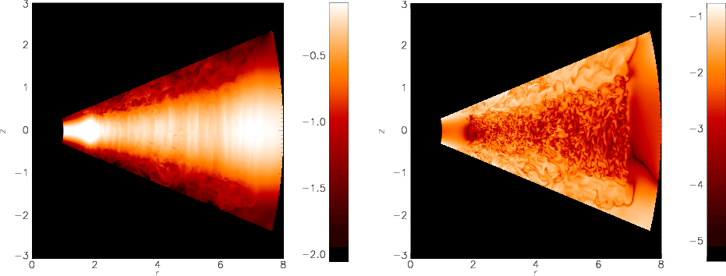
Stratified disc models (Ilgner & Nelson et al 2006)
H/R=0.07 & H/R=0.1 discs computed
Locally isothermal equation of state
~ 9 vertical scale heights
Obtain a basic core-halo structure: Dense MRI-unstable disc near midplane, surrounded by magnetically dominant corona (see also Miller & Stone 2000)

Slide 25
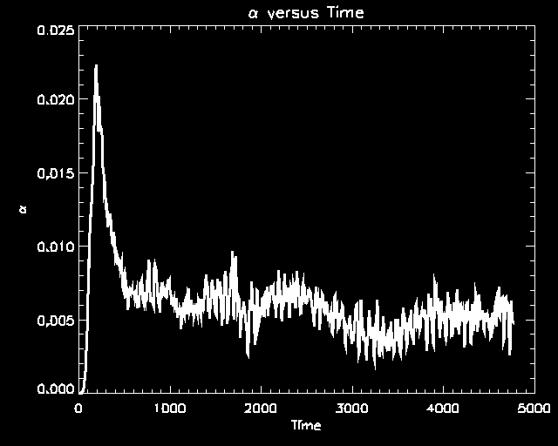
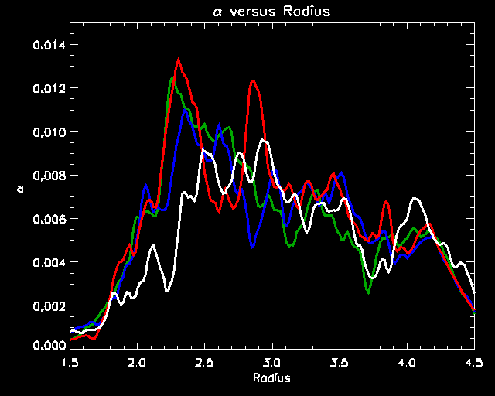

Slide 26
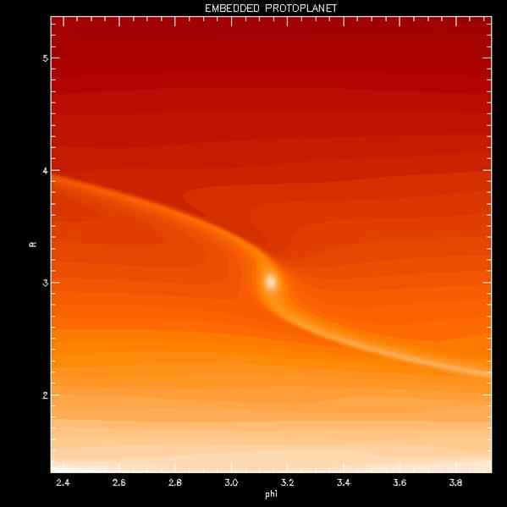
Local view – turbulent fluctuations ≥ spiral wakes

Slide 27
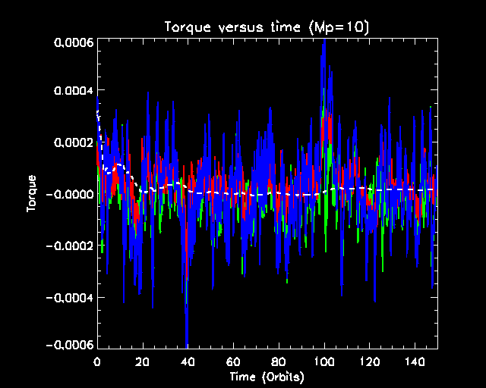
Fluctuating torques – suggest stochastic migration

Slide 28
Turbulence modifies type I migration and may prevent large-scale inward migration for some planets
Stratified global model
H/R=0.1, mp=10 m_{earth}
N_{r} x N _{θ} x N_{φ} = 464 x 280 x 1200

Slide 29
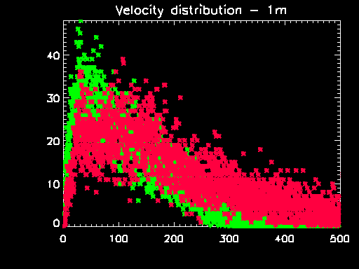
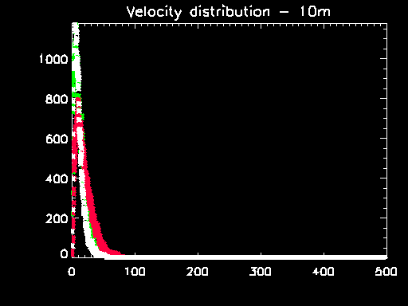
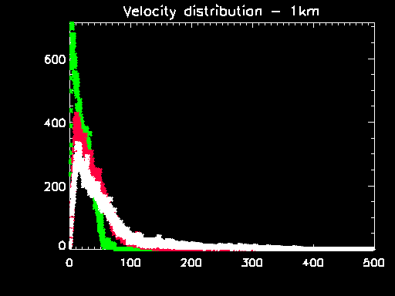
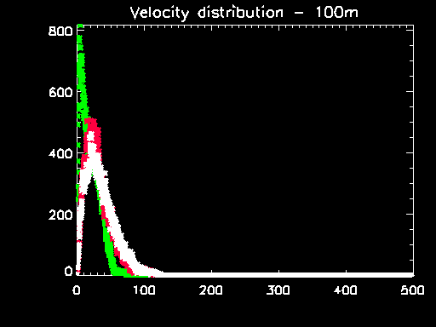
1m-sized bodies strongly coupled to gas. Velocity dispersion ~ turbulent velocities 10m bodies have <v> ~ few x 10 m/s - gas drag efficient at damping random velocities 100m - 1km sized bodies excited by turbulent density fluctuations <v> ~ 50-100 m/s Larger planetesimals prevented from undergoing runaway growth. Planetesimal-planetesimal collisions likely to lead to break-up Need dead-zones to form planets rapidly ? Or leap-frog this phase with gravitational instability – or better yet bunching instability (Youdin 2005)
Nelson 2004:

Slide 30
Dust coagulation
Actually, even smaller bodies cannot coagulate due to turbulence,
interacting with the smallest (Kolmogorov) scales, while
the right parameters are adopted for the large scale eddies
(those need to be smaller than H, and turn over on
dynamical timescale)
If, indeed, there is so much turbulence in the early protoplanetary
disks, then we eventually need selfgravity to build planetesimals.
The end

Slide 31
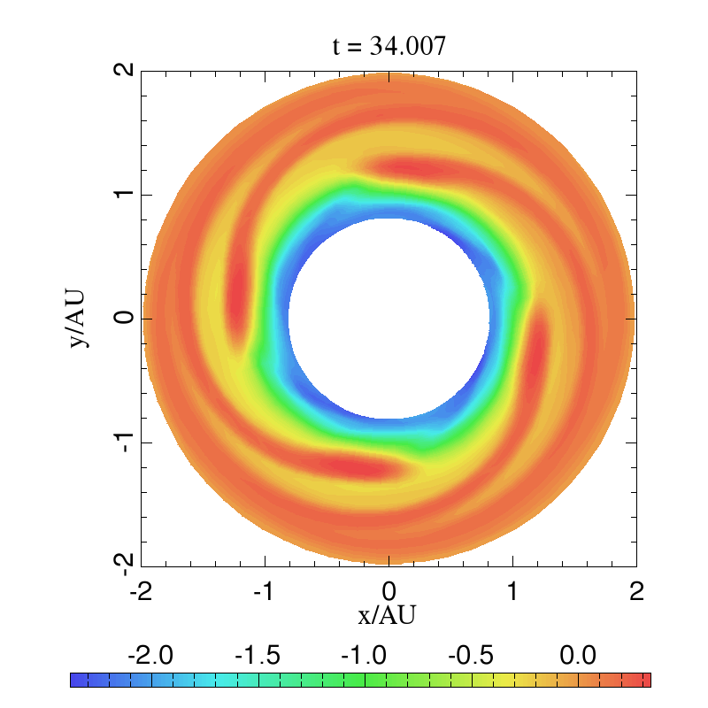
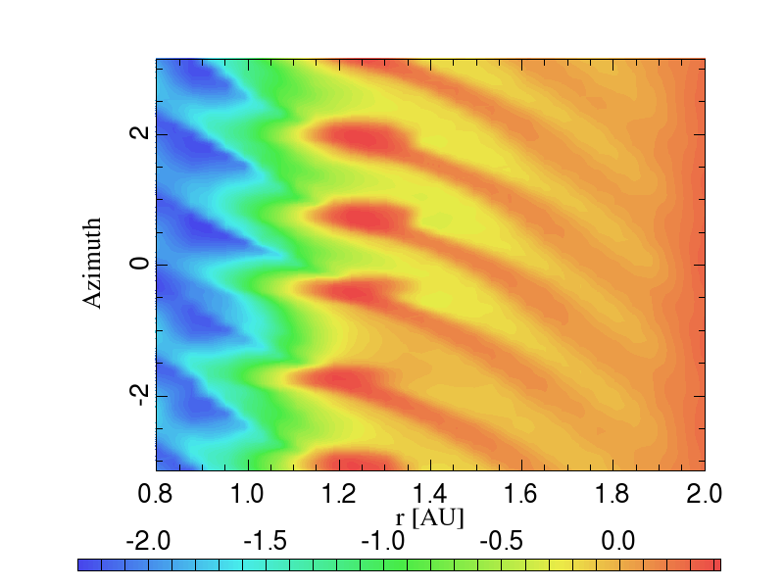
Radiation pressure instability
(see another talk in this school)

Slide 32
Conclusions on optically thick disk structure :
Not only planets but also
Gas + dust + radiation =>
non-axisymmetric features incl. regular m=1
spirals, conical sectors, multi-armed
wavelets, feathers, streams.
the growing turbulence stabilizes
at large values in particulate disks,
growing modes in the gas coalesce into
a low-m, nonlinear pattern with spiral wakes

Slide 33
FINAL THOUGHTS:
Turbulence is there in all accretion disks, either as a driver of viscosity or part of a (most probably) magnetic dynamo.
We are not yet good at DNS-ing it or LES-ing it, or subgrid-modeling it.
We should study non-magnetic instabilities (incl. radiation pressure instability in optically thick disks)
as well as wave-induced transport too.
Turbulence is a serious danger to accumulation
of small solids in disks, but does not directly alter the nature of migration of large bodies. Indirectly, however,
the spatial variations of activity and instability of disks lead to dead zones and other features, saving planets.

